Slide 1
ATLIQ HARDWARE Consumer Goods Ad_Hoc Insights
Presented by- Chandan N
February 2023
SQL PROJECT CHALLENGE

Slide 2
Aim of the project
Atliq Hardware has asked for a business insights project to better understand its clients, the market, and Sales. With the help of this project, the company will have the data it needs to decide wisely and improve its business plan.
Atliq Hardware has become a leading supplier of high-quality hardware. Atliq Hardware recognizes the importance of staying ahead of the competition by identifying key market trends and opportunities for growth.
In this report, I will explore the 10 requests made by Atliq Hardware and provide insights on each one. These requests cover a range of topics, including customer behavior, market analysis, and Revenue. By examining these areas in detail using SQL, I will provide Atliq Hardware with the necessary information to make data-driven decisions and optimize their business strategy.

Slide 3
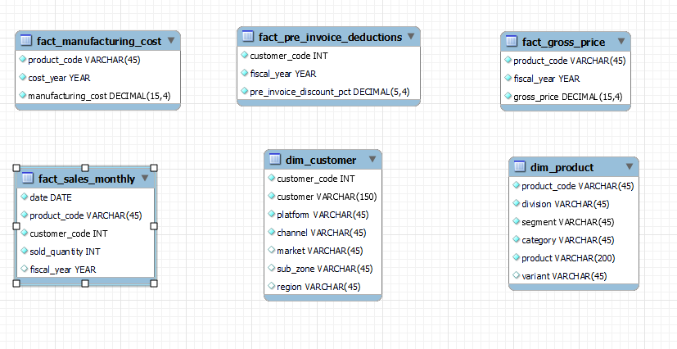
Database includes six main tables:
1. dim_customer: contains customer-related data
2. dim_product: contains product-related data
3. fact_gross_price: contains gross price information for each product
4. fact_manufacturing_cost: contains the cost incurred in the production of each product
5. fact_pre_invoice_deductions: contains pre-invoice deductions information for each product
6. fact_sales_monthly: contains monthly sales data for each product.

Slide 4
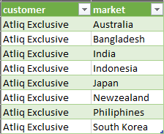
Requests 1: Provide the list of markets in which customer "Atliq Exclusive" operates its business in the APAC region.
Insights
Result indicates “Atliq Exclusive” have customers from 8 different countries when it's operated in APAC region.

Slide 5
Requests 2: What is the percentage of unique product increase in 2021 vs. 2020? The final output contains these fields, unique_products_2020 unique_products_2021 percentage_chg
Insights
Results indicates that no of Unique products have raised by 33.3% in the year 2021 compared to Fiscal year 2020.

Slide 6
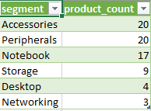
Requests 3: Provide a report with all the unique product counts for each segment and sort them in descending order of product counts. The final output contains 2 fields, segment product_count
Insights
Atliq hardware produces most of the products from Accessories, peripherals, Notebook compares to other segments.

Slide 7
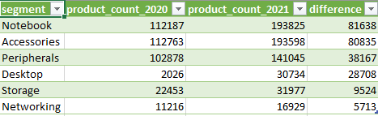
Requests 4: Follow-up: Which segment had the most increase in unique products in 2021 vs 2020? The final output contains these fields, segment, product_count_2020, product_count_2021, difference.
Insights
Result shows that Atliq hardware as increased its production in every segment in the year 2021 compared to 2020 to meet the customer requirements.

Slide 8
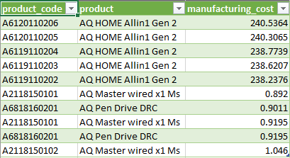
Requests 5: Get the products that have the highest and lowest manufacturing costs. The final output should contain these fields, product_code product manufacturing_cost
Insights
Result indicates the Manufacturing cost of products ranges from 0.8$ to 240.53$.

Slide 9
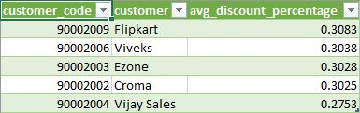
Requests 6: Generate a report which contains the top 5 customers who received an average high pre_invoice_discount_pct for the fiscal year 2021 and in the Indian market. The final output contains these fields, customer_code customer average_discount_percentage 7.
Insights
Result shows the Top 5 customers with the highest average pre_invoice_discount_pct for the fiscal year 2021 in the Indian market

Slide 10
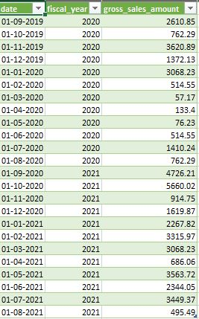
REQUEST 7: Get the complete report of the Gross sales amount for the customer “Atliq Exclusive” for each month . This analysis helps to get an idea of low and high-performing months and take strategic decisions. The final report contains these columns: Month Year Gross sales Amount
Insights
Result gives a report of gross sales for customer Atliq Exclusive this analysis helps management to understand seasonal trends which can also help Atliq hardware's to optimize its inventory management.

Slide 11
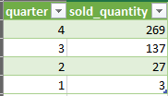
Requests 8: In which quarter of 2020, got the maximum total_sold_quantity? The final output contains these fields sorted by the total_sold_quantity, Quarter total_sold_quantity
Insights
Results indicates that atliq hardware's sold less products in quarter 1 compared to quarter 4. this also shows that Atliq hardware is also updating on customers needs every quarter and meeting their requirements clearly.

Slide 12

REQUEST 9: Which channel helped to bring more gross sales in the fiscal year 2021 and the percentage of contribution? The final output contains these fields, channel gross_sales_mln percentage
Here I have Analyzed data by channel to understand the most effective sales channels, which also helps to optimize marketing strategies

Slide 13
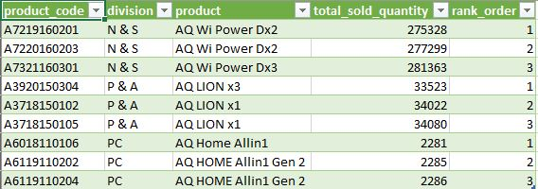
REQUEST 10: Get the Top 3 products in each division that have a high total_sold_quantity in the fiscal_year 2021? The final output contains these fields, division product_code
Insights
Above table shows that division N&S has sold more products compared to PC and stood at rank 1 where pc division has less sales with the rank of 3.

Slide 14
Summary
Identified the markets in the APAC region in which Atliq Exclusive operates its business, which include Australia, China, India, Japan, South Korea, Malaysia, Philippines, Singapore, Taiwan, and Thailand.
Calculated the percentage increase in unique products sold in 2021 compared to 2020 to identify trends in customer demand and potential opportunities for growth.
Analyzed customer data by segment to identify unique product counts and sorted them in descending order to understand the most popular products for each segment.
Identified the segment with the highest increase in unique products sold in 2021 compared to 2020 to optimize marketing and sales strategies for that segment.
Identified the products with the highest and lowest manufacturing costs to optimize pricing strategies and increase profitability.
Top 5 customers with the highest average pre_invoice_discount_pct for the fiscal year 2021 in the Indian market
Analyzed customer data in the Indian market to identify the top 5 customers with the highest average pre_invoice_discount_pct in the fiscal year 2021 to optimize pricing strategies and increase customer loyalty.
Analyzed sales data by month for Atliq Exclusive to understand seasonal trends and optimize inventory management.
Identified the quarter of 2020 with the highest total_sold_quantity to understand trends in customer demand and optimize inventory management.
Analyzed sales data by channel to understand the most effective sales channels and optimize marketing strategies.
Analyzed product data by division to identify the top 3 products with the highest total_sold_quantity in the fiscal year 2021 to optimize inventory management and increase profitability.

Slide 15
Thank you
ChandanN
Chandanregins1@gmail.com
https://github.com/chandan-nagaraju/Consumer_goods

